Slide 1
Running a Program

Slide 2
Running a program
Software programs are sets of instructions. For a CPU to execute these instructions, each one must first be translated into machine code – simple binary codes that activate parts of the CPU.
The CPU only performs a few basic functions:
performing mathematical operations like addition and subtraction
moving data from one memory location to another
making decisions and jumps to a new set of instructions based on those decisions
A piece of software, such as a game or web browser, combines these functions to perform more complex tasks

Slide 3
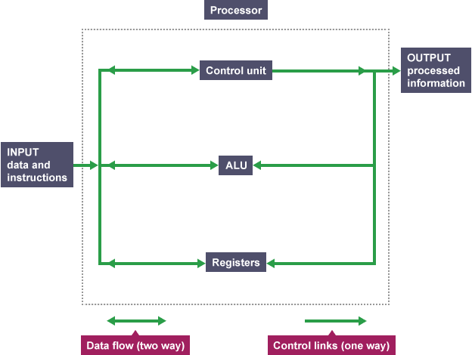

Slide 4
Instructions
Most programmers do not write programs as sequences of binary digits. They use programming languages like Java, C++, Ruby, BASIC or Python. These are also known as high-level programming languages.
High-level languages need to be translated into a binary code before the CPU can execute them. The benefit of high-level languages is that they are more like everyday written language than sequences of binary numbers, so people find them easier to write and understand.

Slide 5
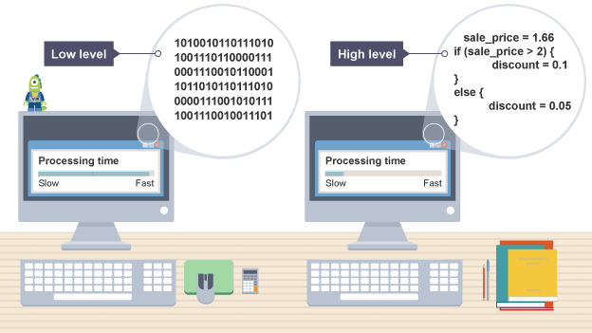
Low level Vs High Level programs

Slide 6
Low level Vs High Level programs
Human-readable language instructions are encoded in a language that humans can understand more easily. This includes high- and low-level languages. Low-level languages, such as assembly language, more closely reflect the mechanical workings of the CPU.
Machine-readable language instructions are written using only the binary codes of the processor's instruction set.

Slide 7
Translators
A piece of translator software, which is usually included within programming software, converts high-level languages into machine code. These translators are known as compilers and interpreters. Programs are translated using either a compiler or interpreter.
Compiler
A compiler translates a human-readable program directly into an executable, machine-readable form before the program can run.
Interpreter
An interpreter translates a human-readable program into an executable, machine-readable form, instruction by instruction. It then executes each translated instruction before moving on to the next one. A program is translated every time it is run. Python is an example of an interpreted language.

Slide 8
Instructions are decoded as a set of sequenced operations. These operations instruct the ALU and control unit inside the CPU

Slide 9
Opcode and operands
Opcode
The opcode tells the processor the job that needs to be done. A simple operation might be 'add' or 'subtract'. If we use the analogy of a recipe, the opcode might be 'chop' or 'mix'.
Each opcode instruction is very limited in what it can tell the processor to do. A CPU's instruction set contains the opcodes that it will accept.
There are two types of opcode:
an opcode that tells the circuitry which operation to carry out
an opcode along with some data to be processed
Operand
The operand specifies the data that needs to be acted on. The operand can also refer to a place in memory, such as a register.
If we use the analogy of a recipe, an ingredient (eg an onion) is the thing being acted upon by the opcode. So the opcode 'chop' could act on the operand 'onion'. If the operand refers to a place in memory, this could be seen as the 'chopping board'. The operand (data) 'onion' could be in the memory location 'chopping board'. The instruction could be to chop the onion on the chopping board.

Slide 10
Assembly language
Assembly language is a low-level language which closely reflects how opcodes and operands work. It is much quicker for computers to convert assembly instructions to machine code than to convert high-level source code to machine code.
Typical assembly language opcodes include:
add
subtract
load
compare
branch
store

Slide 11
Working Details
Mnemonics
Assembly language instructions use abbreviations called mnemonics. An example of a mnemonic assembly language instruction is LDA 50which stores the value 50 into a register of the CPU. Mnemonics are easier for humans to remember and understand than binary machine code instructions

Slide 12
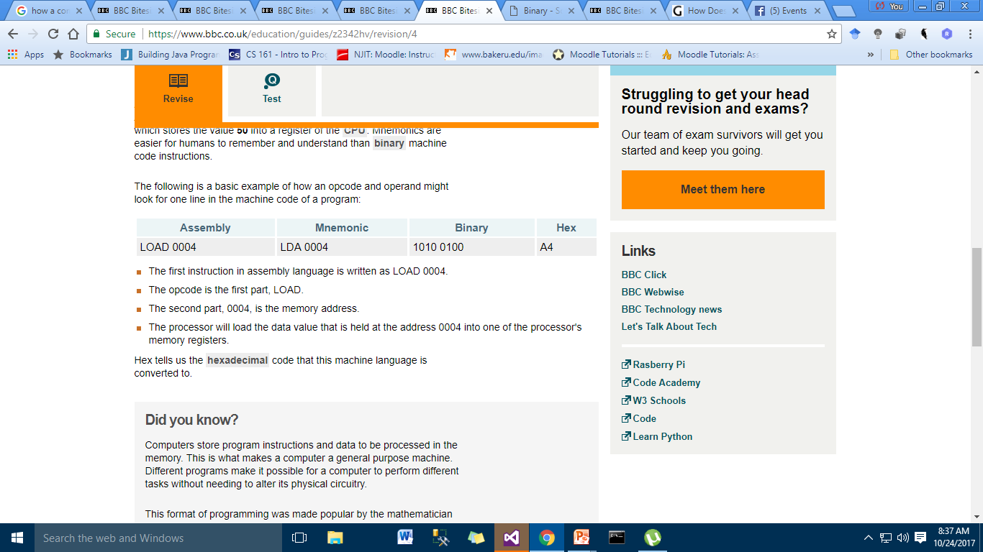

Slide 13
